Slide 1
ADA PROJECT
SUBMITTED BY:--
VARUN KUMAR (2K19/IT/140)
YASHIT KUMAR (2K19/IT/149)

Slide 2
SUDOKU SOLVER

Slide 3
INTRODUCTION
The Sudoku puzzle has become a very popular puzzle.
The puzzle consists of a 9×9 grid in which some of the entries of the grid have a number from 1 to 9.
Filling the table with the numbers must follow these rules: --
Numbers in rows are not repeated
Numbers in columns are not repeated
Numbers in 3 × 3 blocks are not repeated
Order of the numbers when filling is not important

Slide 4
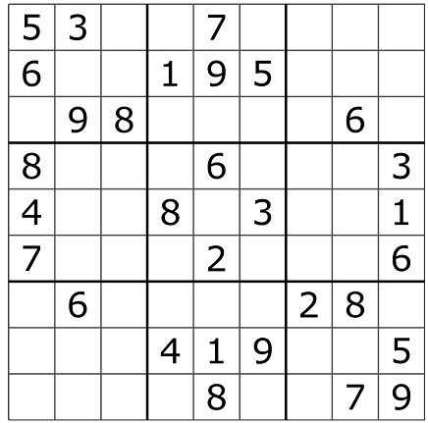
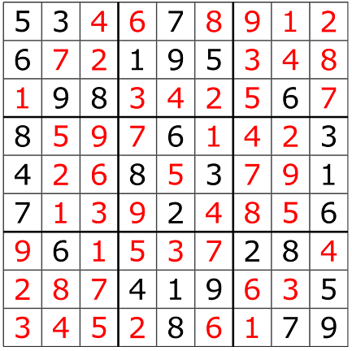
SAMPLE SUDOKU PUZZLE SOLVED SUDOKU PUZZLE

Slide 5
Why Sudoku ?
Keeps your brain alive and active, a useful break from your usual routine.
Develops some logical thinking and patterns.
Helps in improving your patience and concentration.
Improves sharpness and strategy while approaching and solving problems since you need to be accurate while putting digits and aware of the placement of other digits.

Slide 6
Continued-
Enables you to learn, improve and compete against yourself (based on solving times), thus enhancing your skill-sets and competitive spirit.
Gives you a sense of accomplishment on completing the grid within few minutes.
It can build your interest in the world of grid-based puzzles, and sudoku competitions, locally, nationally, or globally.
It is one of the simplest sports/games/activities to learn, enjoy, play/solve, and even teach.

Slide 7
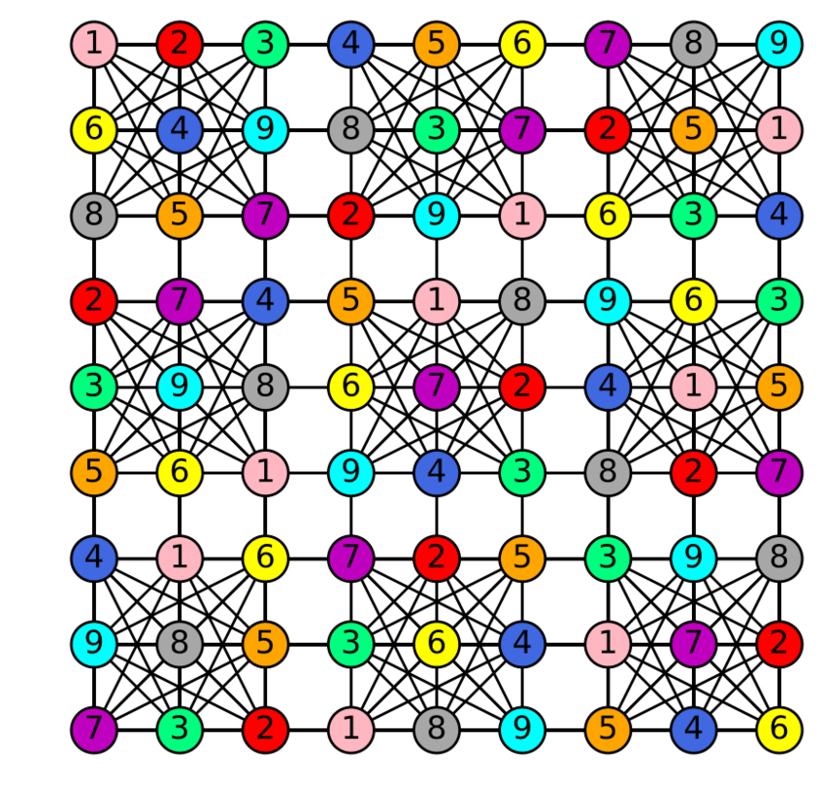

Slide 8
Algorithm Used
Recursion and Backtracking
The idea is to assign numbers from 1 to 9 one by one to boxes, starting from first box .
Before assigning a number , check for safety by considering already assigned number to the adjacent boxes.
Check if the adjacent boxes have the same color or not by traversing the sudoku in the same row , column and subgrid.

Slide 9
If the box we reached by traversing has the same number as of the initial box then we have to assign different number to the initial box .
And if we are not able to assign any number to current box then we have to backtrack and change the number of previous box.
If we able to assign number to the box then we will move to next box in the row.
If no assignment of number is possible then in that case we are not able to solve Sudoku and hence puzzle is unsolvable.

Slide 10
Features
User can play the game and It can be played in Easy , Medium and Hard mode
User can solve its manually entered puzzle .
User can get the hint while solving the puzzle
User can erase its move.
User can unlock the row or column while playing.
User can get the complete solution if he wants.
Language Used : C++

Slide 11
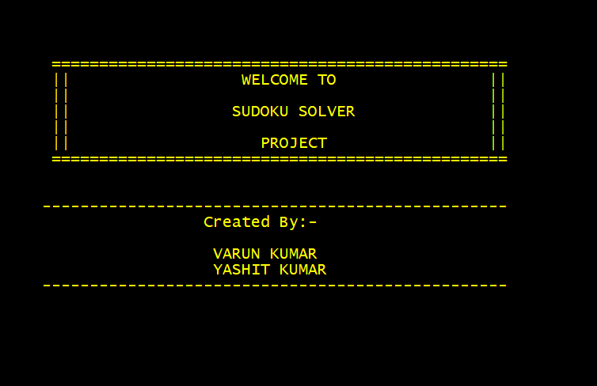

WORKING DEMO

Slide 12
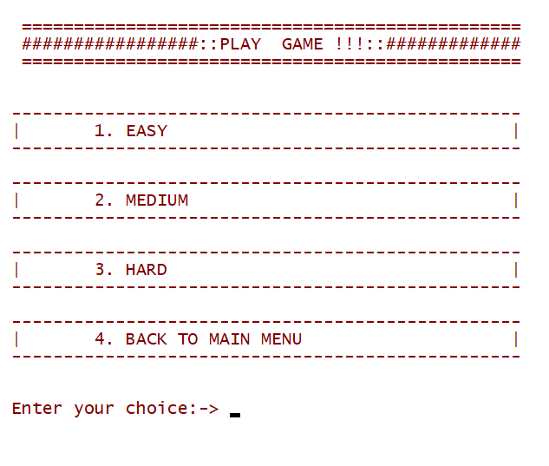
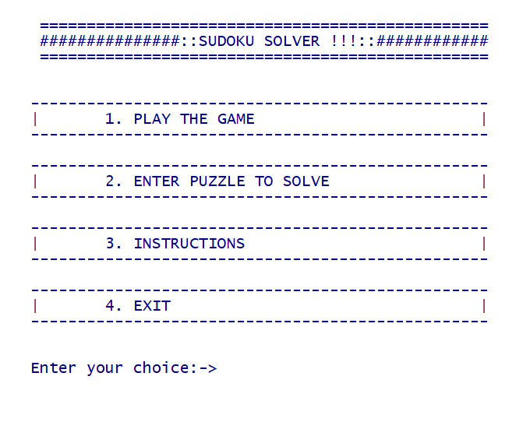
MAIN MENU

Slide 13
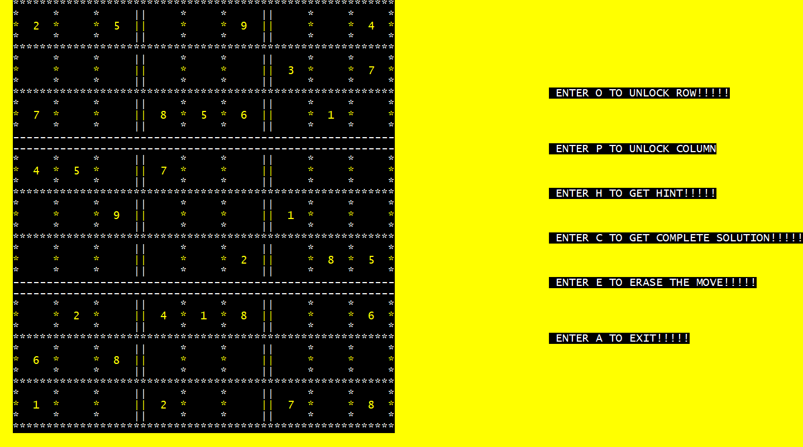
USER CAN SOLVE EASY , MEDIUM AND HARD PUZZLES

Slide 14
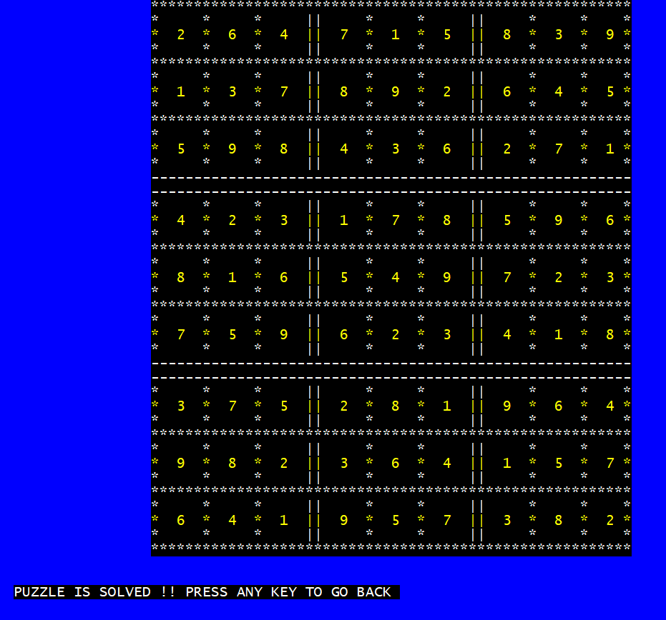
USER CAN GET THE COMPLETE SOLUTION

Slide 15
THANK YOU

